Slide 1
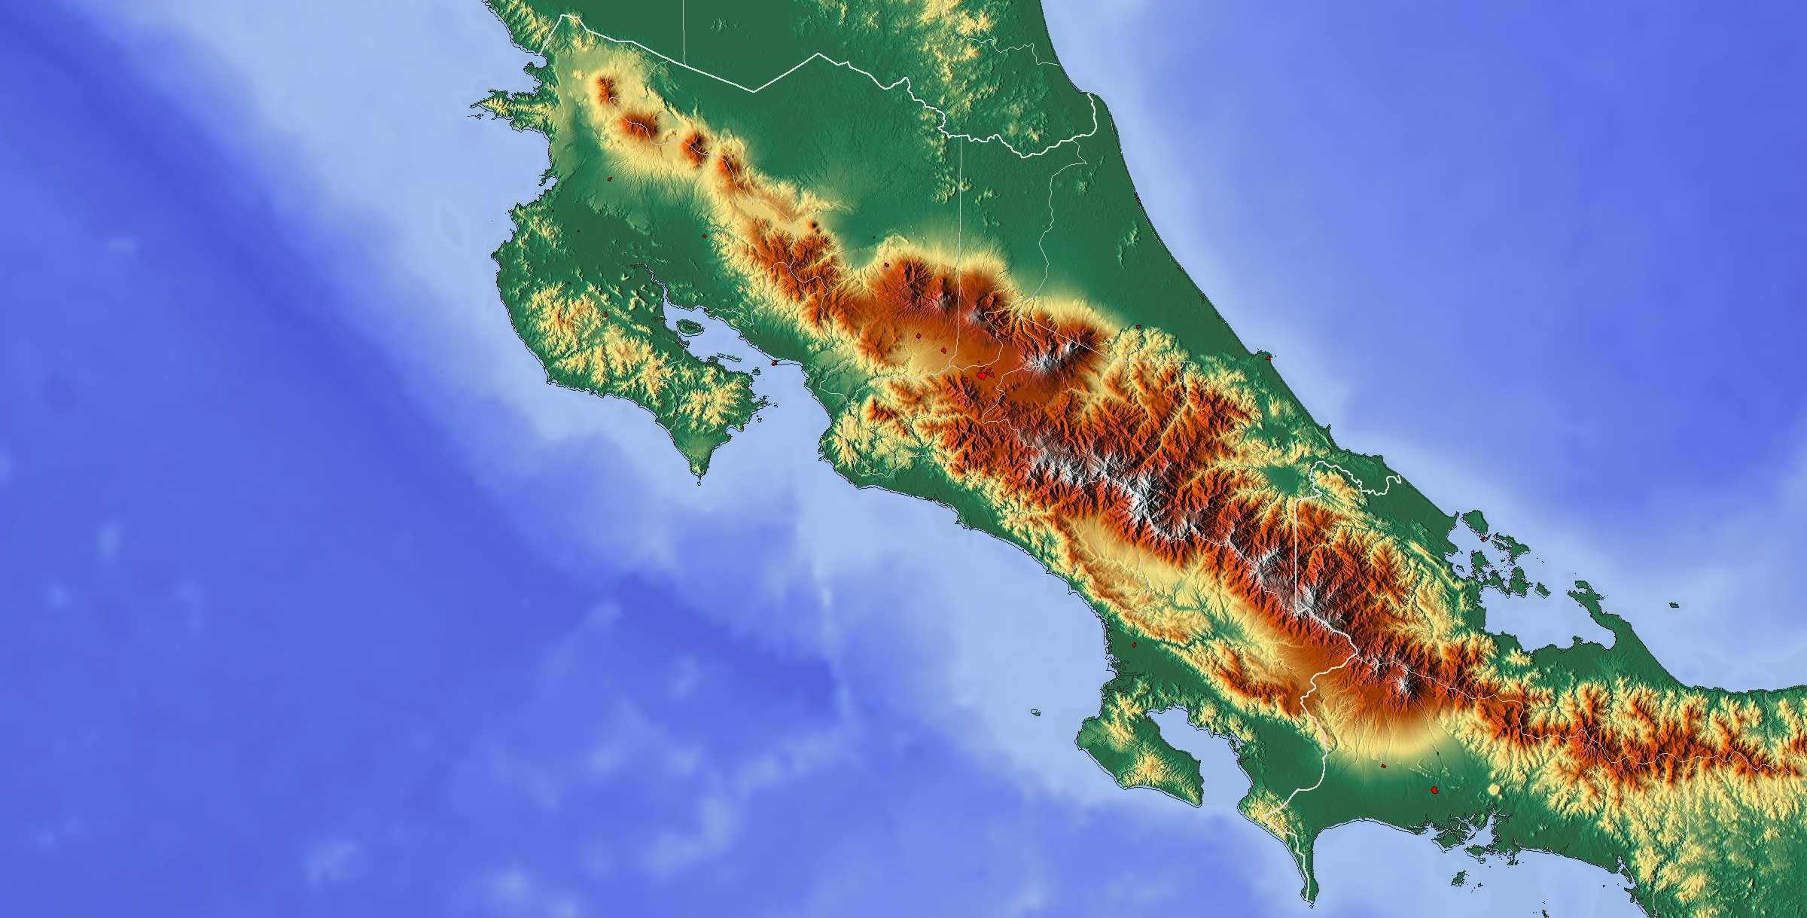
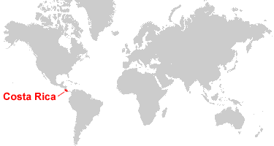
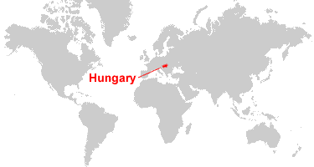
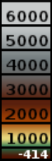
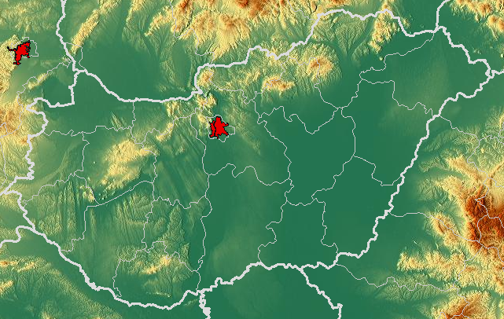
Nicaragua
a
Costa Rica
Caribbean Sea
San José
Pacific
Ocean
Extra-Tropics
metres
Hungary
Panama
Costa
Tropics
Rica
Extra-Tropics
Ukraine
Slovakia
Austria
Budapest
Hungary
Slovenia
Romania
Bosnia and
Herzegovina
Serbia
b

Slide 2
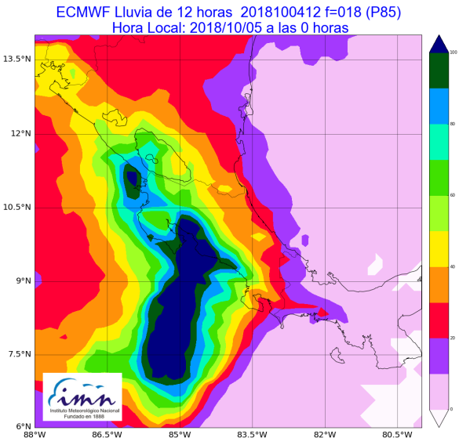

13.5 °N
100
12 °N
80
10.5 °N
60
[mm/12h]
8 °N
40
6.5 °N
20
0
88 °W 86.5 °W 85 °W 83.5 °W 82 °W 80.5 °W

Slide 3
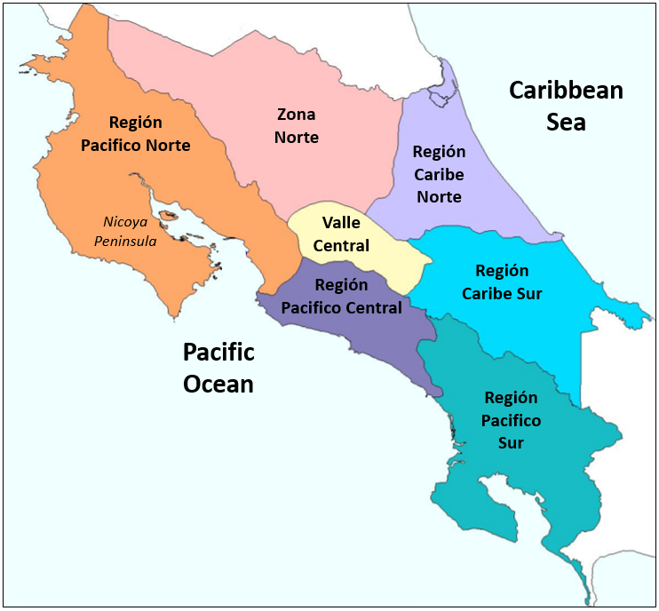
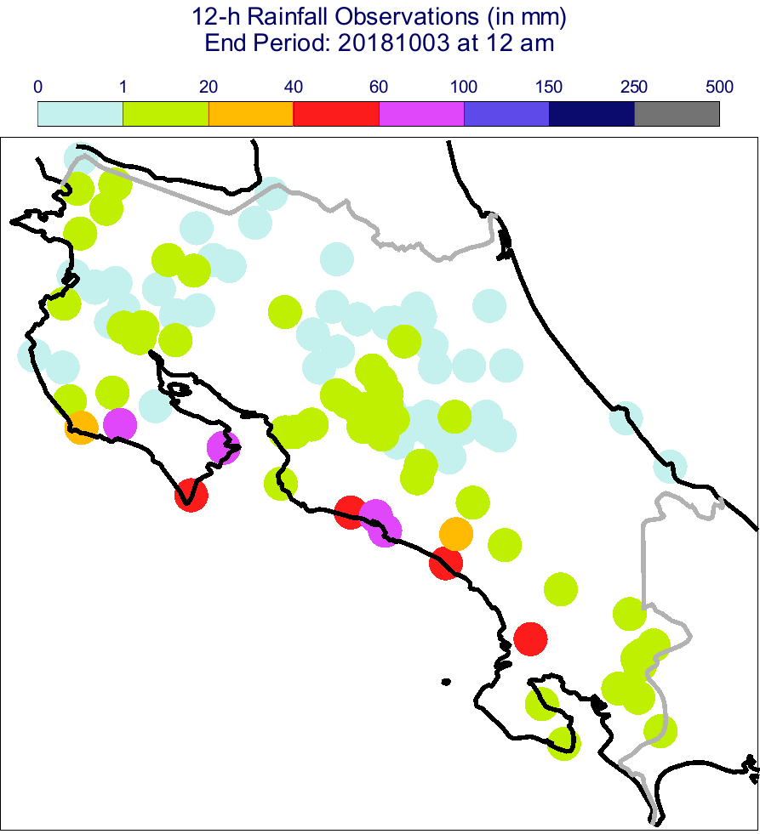
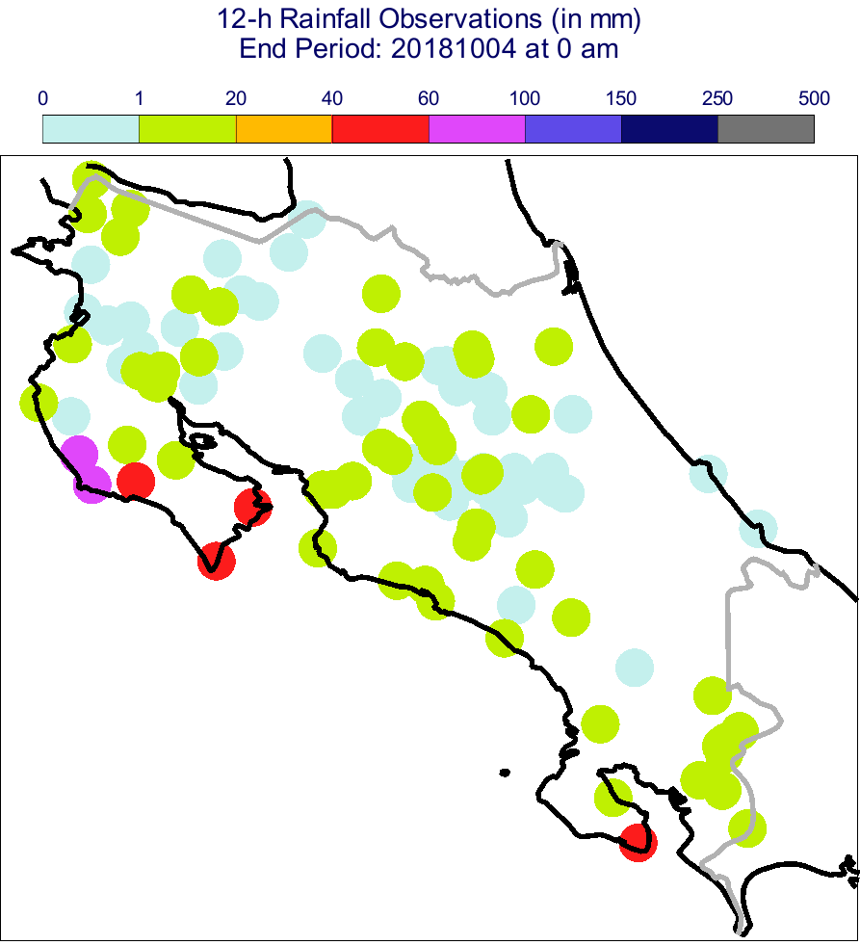

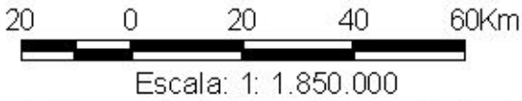
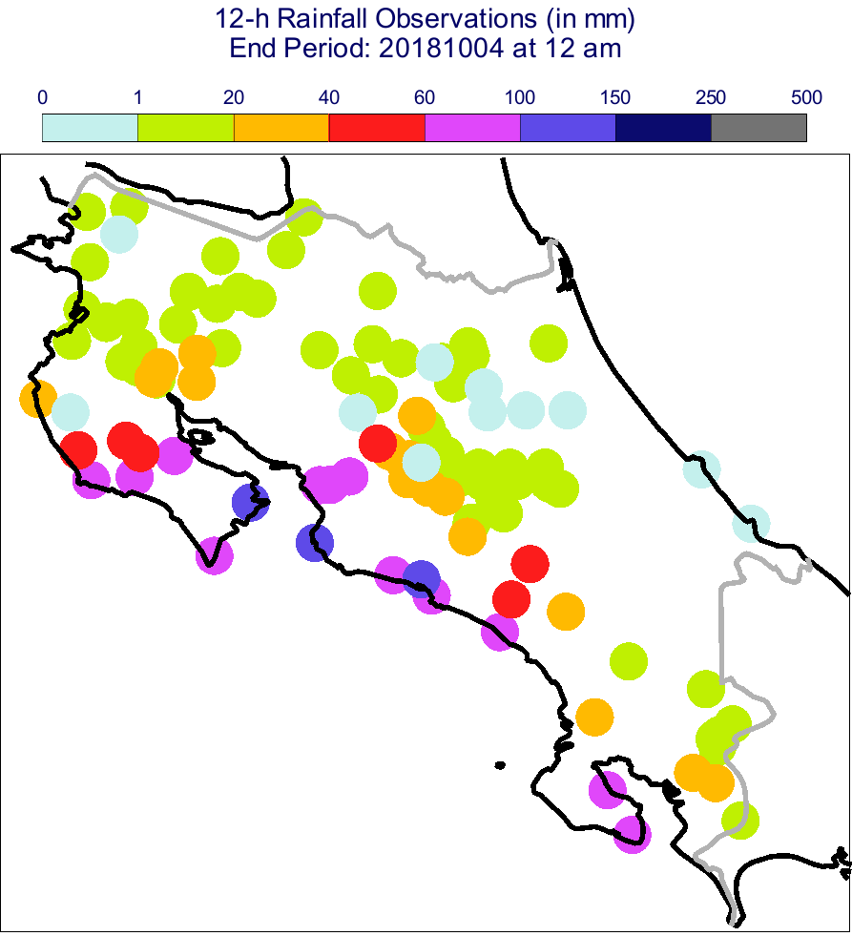
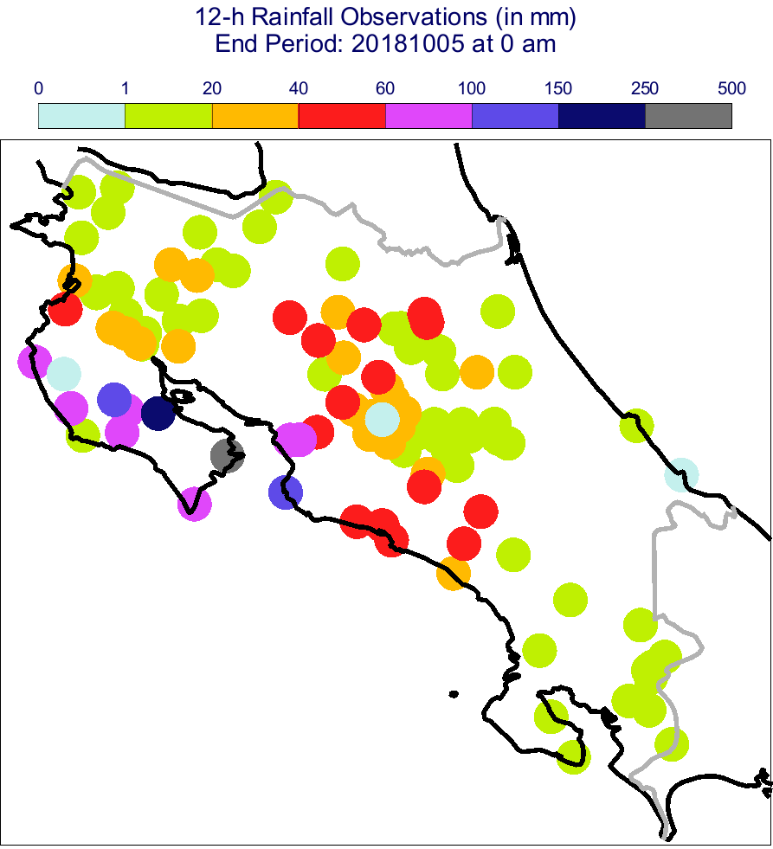
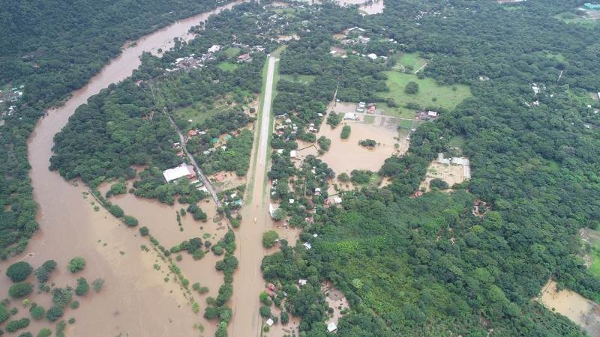
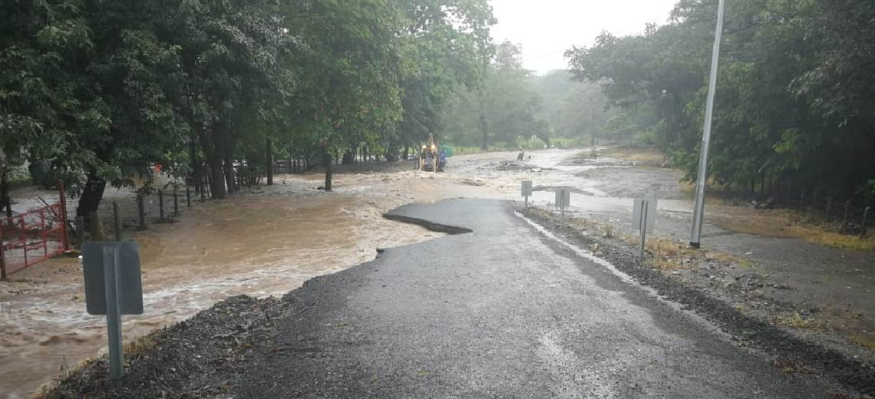
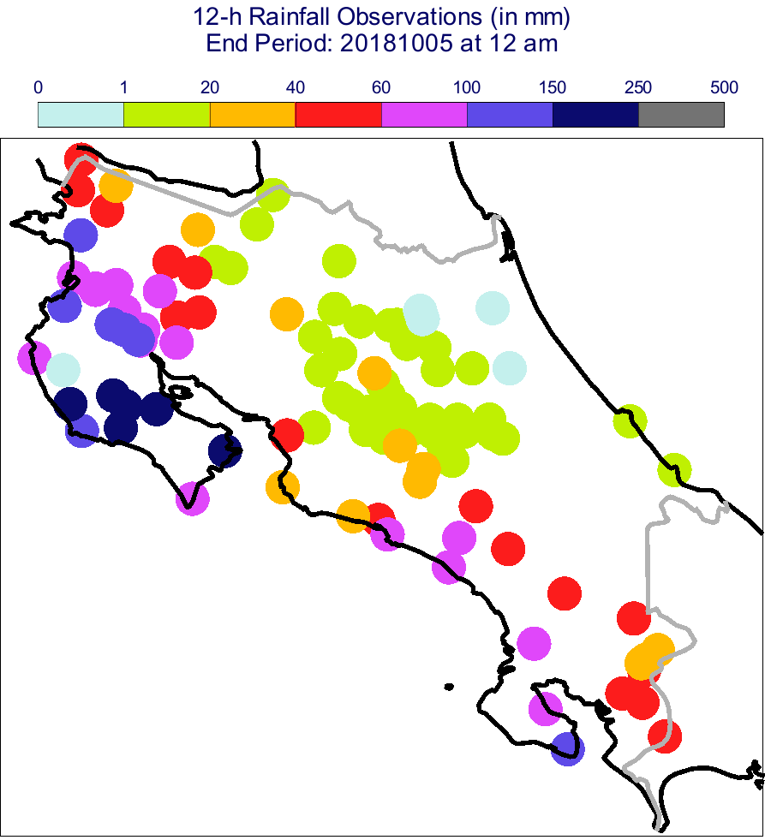
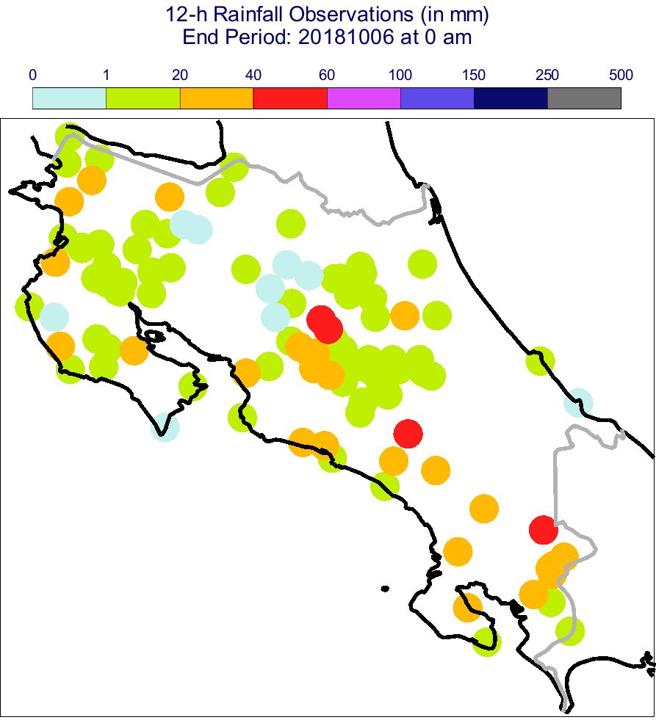
a
mm / 12h
0 1 20 40 60 100 150 250 500
Región
Pacifico Norte
Zona
Norte
Región
Caribe
Norte
Caribbean
O-1
O-2
Sea
Nicoya
Valle
Peninsula
Central
Región
Caribe Sur
Región
Pacifico
Central
20 0 20 40 60 km
Región
Pacifico
Sur
2018/10/03 6 UTC to 2018/10/03 18 UTC
(LT: 2018/10/03 0 am
to 2018/10/03 12 am)
2018/10/03 18 UTC to
2018/10/04 6 UTC
(LT: 2018/10/03 12 am
to 2018/10/04 0 am)
Scale 1: 1.850.000
Pacific
Ocean
O-3
O-4
i-1
2018/10/04 6 UTC to
2018/10/04 18 UTC
(LT: 2018/10/04 0 am
to 2018/10/04 12 am)
2018/10/04 18 UTC to
2018/10/05 6 UTC
(LT: 2018/10/04 12 am
to 2018/10/05 0 am)
i-2
O-5
O-6
2018/10/05 6 UTC to
2018/10/05 18 UTC
(LT: 2018/10/05 0 am
to 2018/10/05 12 am)
2018/10/05 18UTC to
2018/10/06 6 UTC
(LT: 2018/10/05 12 am
to 2018/10/06 0 am)

Slide 4
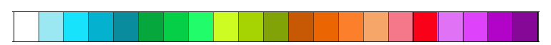
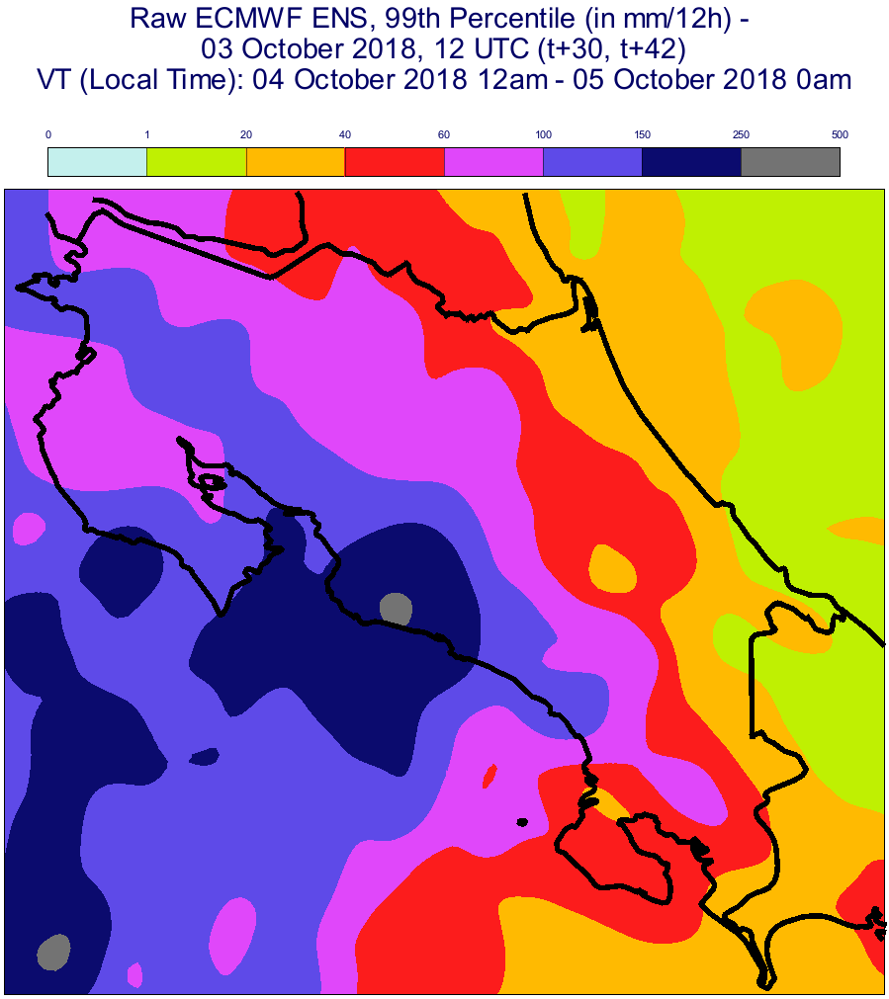
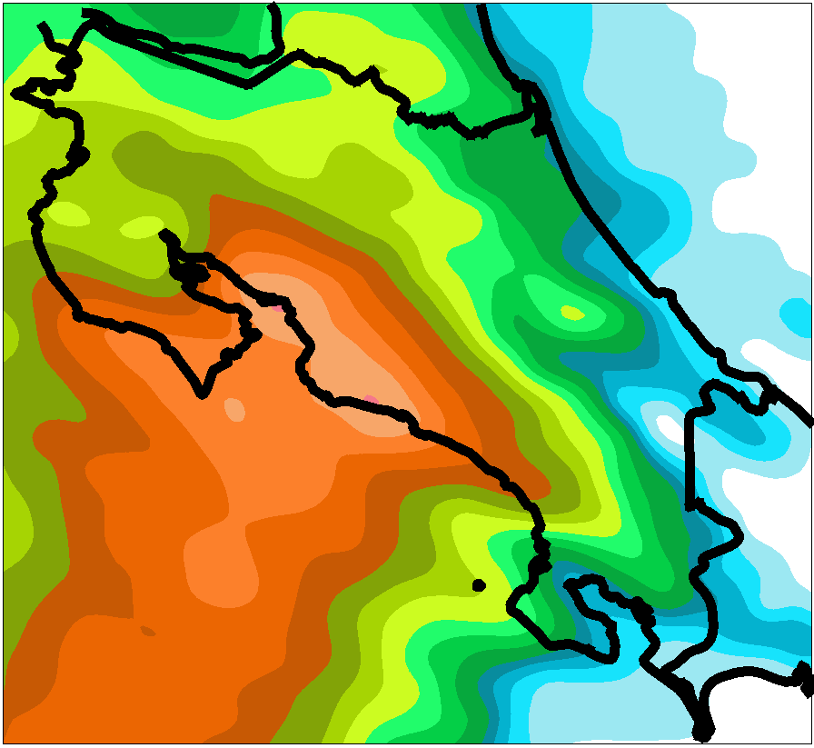
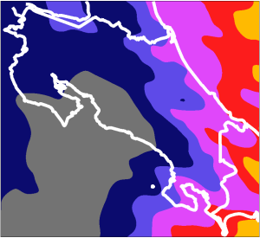
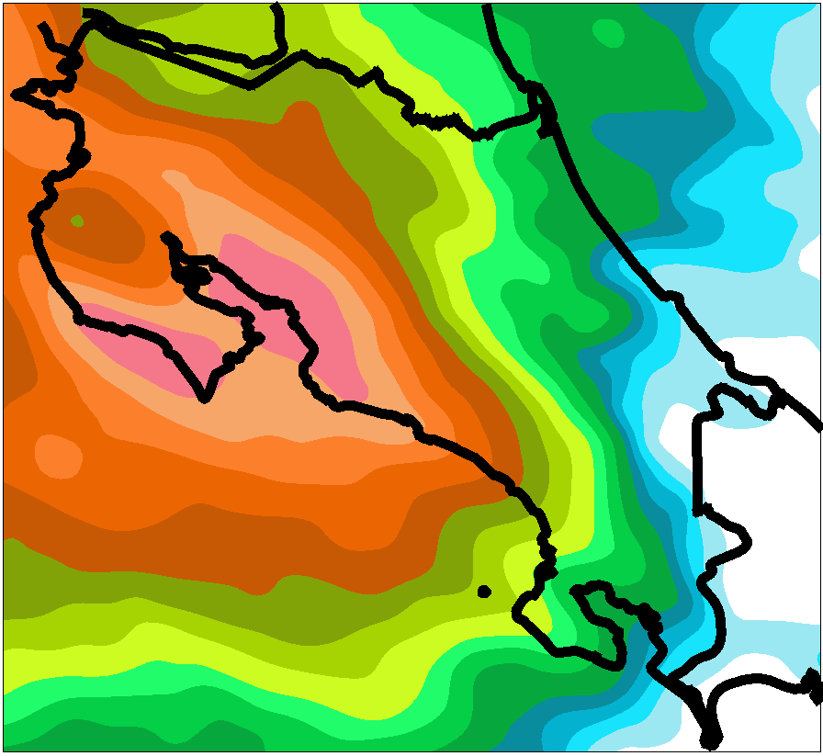
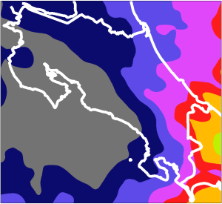
Prob. (in %) of exceeding 50 mm/12h
99th Percentile (in mm/12h)
20.5
35.5
80.5
16.5
50.5
70.5
90.5
30.5
40.5
60.5
13.5
25.5
0.5
10.5
40
150
250
500
0
2.5
3.5
4.5
8.5
1.5
6.5
0
1
20
60
100
100
a
b
2018/10/04 00 UTC (t+18,t+30)
VT (LT): 2018/10/04 12am to 2018/10/05 0am
c
d
2018/10/04 12 UTC (t+18,t+30)
VT (LT): 2018/10/05 0am to
2018/10/05 12am

Slide 5
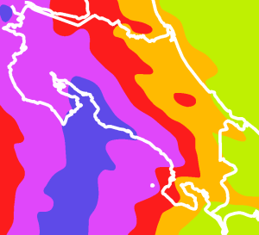
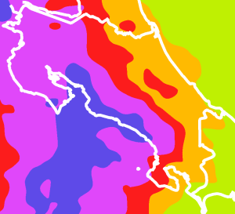
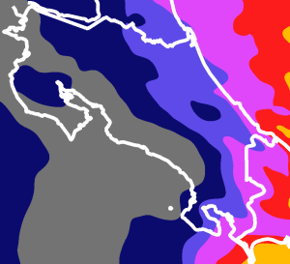
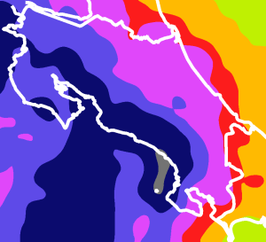
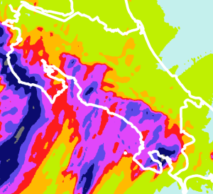
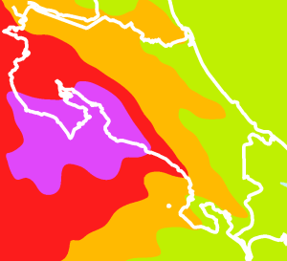
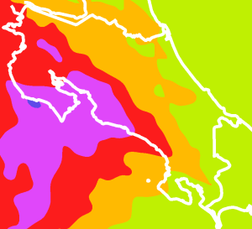
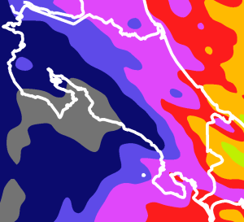
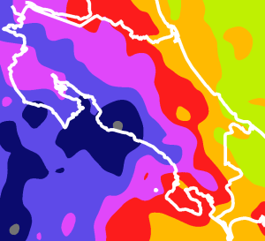
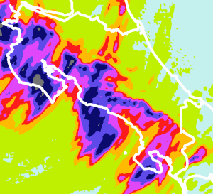
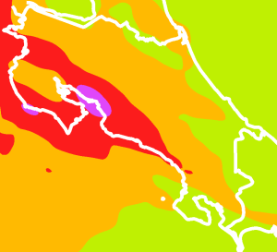
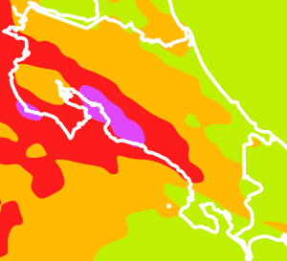
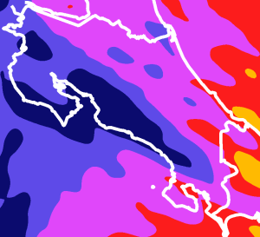
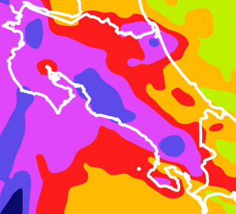
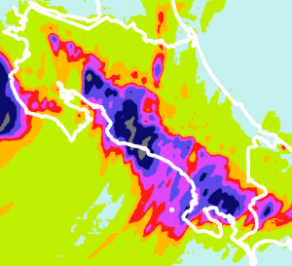
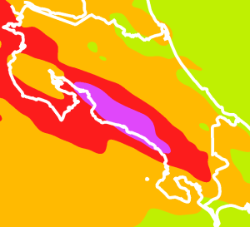
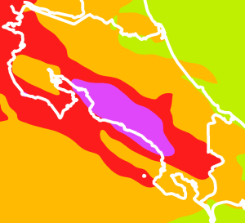
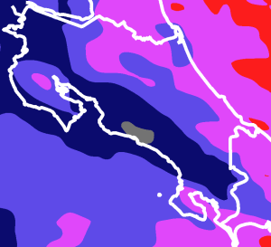
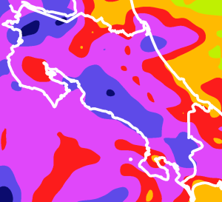
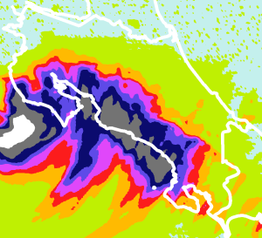
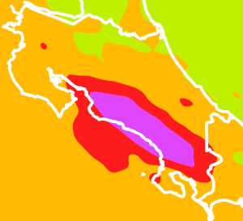
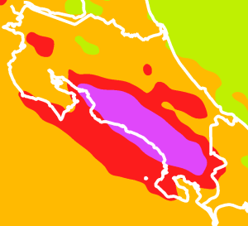
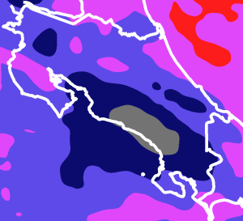
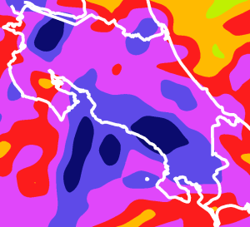
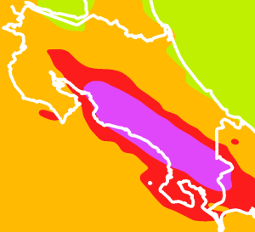
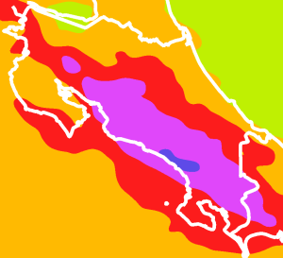
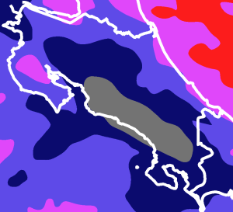
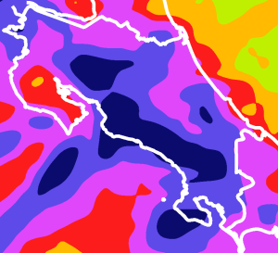




mm / 12h
0 1 20 40 60 100 150 250 500
85th Percentile
ecPoint-Rainfall
85th Percentile
Raw ENS
99th Percentile
ecPoint-Rainfall
Wettest Member
Raw ENS
Deterministic WRF-1.5
(from IMN)
DAY 1
2018/10/04 12UTC (t+6,t+18)
DAY 1
2018/10/04 18UTC (t+0,t+12)
DAY 2
2018/10/03 12UTC (t+30,t+42)
DAY 2
2018/10/03 18UTC (t+24,t+36)
DAY 3
2018/10/02 12UTC (t+54,t+66)
DAY 3
2018/10/02 18UTC (t+48,t+60)
DAY 4
2018/10/01 12UTC (t+78,t+90)
DAY 4
2018/10/01 18UTC (t+72,t+84)
VT (LT): 2018/10/04 12am to 2018/10/05 0am
Missing
DAY 5
2018/09/30 12UTC (t+102,t+114)
DAY 5
2018/09/30 18UTC (t+96,t+108)
Not Available
(WRF-1.5 max lead time corresponds to t+120)
DAY 6
2018/09/29 12UTC (t+126,t+138)
DAY 6
2018/09/29 18UTC (t+120,t+132)
Not Available
(WRF-1.5 max lead time corresponds to t+120)
DAY 7
2018/09/28 12UTC (t+150,t+162)
DAY 7
2018/09/28 18UTC (t+144,t+156)

Slide 6




FC: 2018/10/04, 00UTC (t+18,t+30)
VT (LT): 2018/10/04 12 am - 2018/10/05 0 am
FC: 2018/10/04, 12UTC (t+18,t+30)
VT(LT): 2018/10/05 0 am - 2018/10/05 12 am
South Coast of
Nicoya Peninsula
Raw ENS ecPoint-Rainfall
100
80
60
Prob. [%] to not exceed
40
20
a
b
0
Inland Parts of
Nicoya Peninsula
100
80
60
Prob. [%] to not exceed
40
20
c
d
0
0 100 200 300 400 500
Total precipitation [mm/12h]
0 100 200 300 400 500
Total precipitation [mm/12h]

